Slide 1






Predicting Prescription Drug Shortages (Healthcare Industry) Case Study: “Ozempic Shortage”
Statistical Foundations for Business Analytics OM-509
Final Project Presentation
Presented by
Ahmed Albahhar | Ayasha Saquib
Taghreed Al Qahtani | Chigozie Obasi

Slide 2



01
Introduction

Slide 3
What Are Drug Shortages?
Drug shortages refer to a situation where the supply of a medication is insufficient to meet the demand.

Slide 4
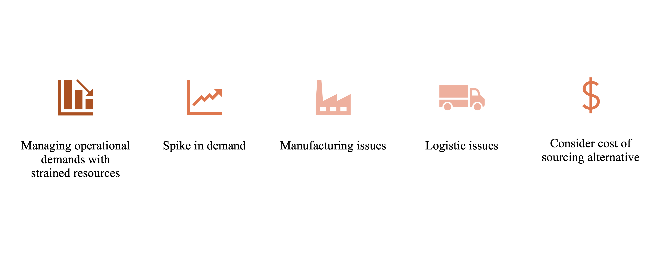
Causes of shortages and their impact

Slide 5
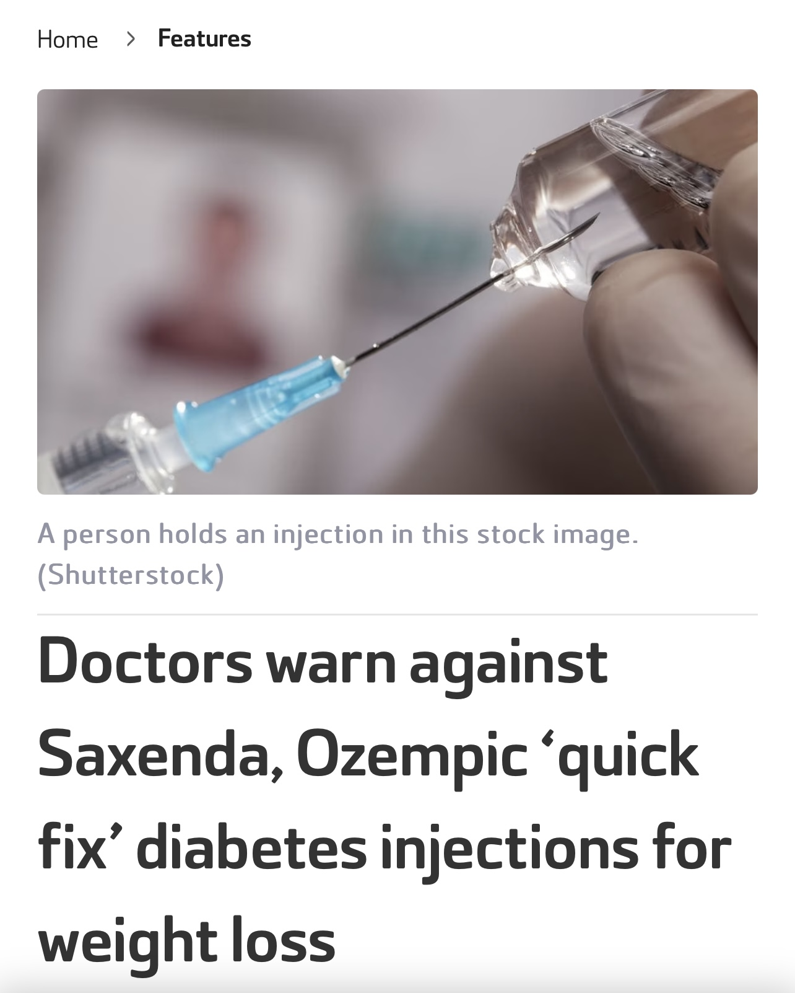


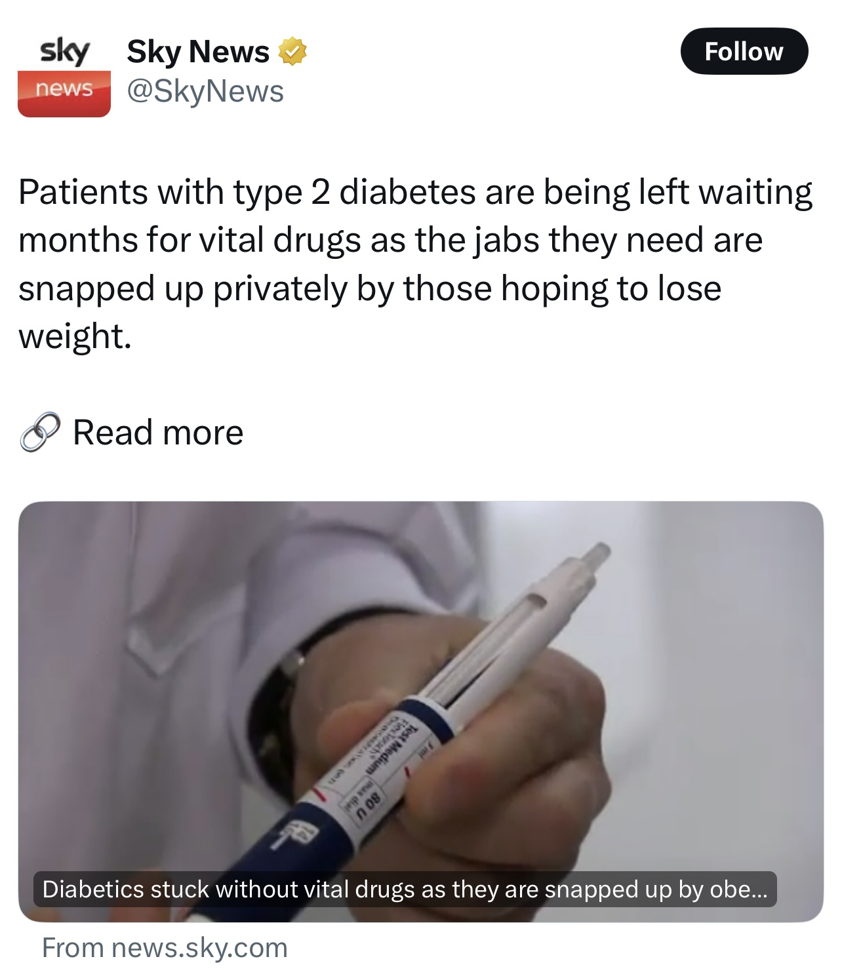
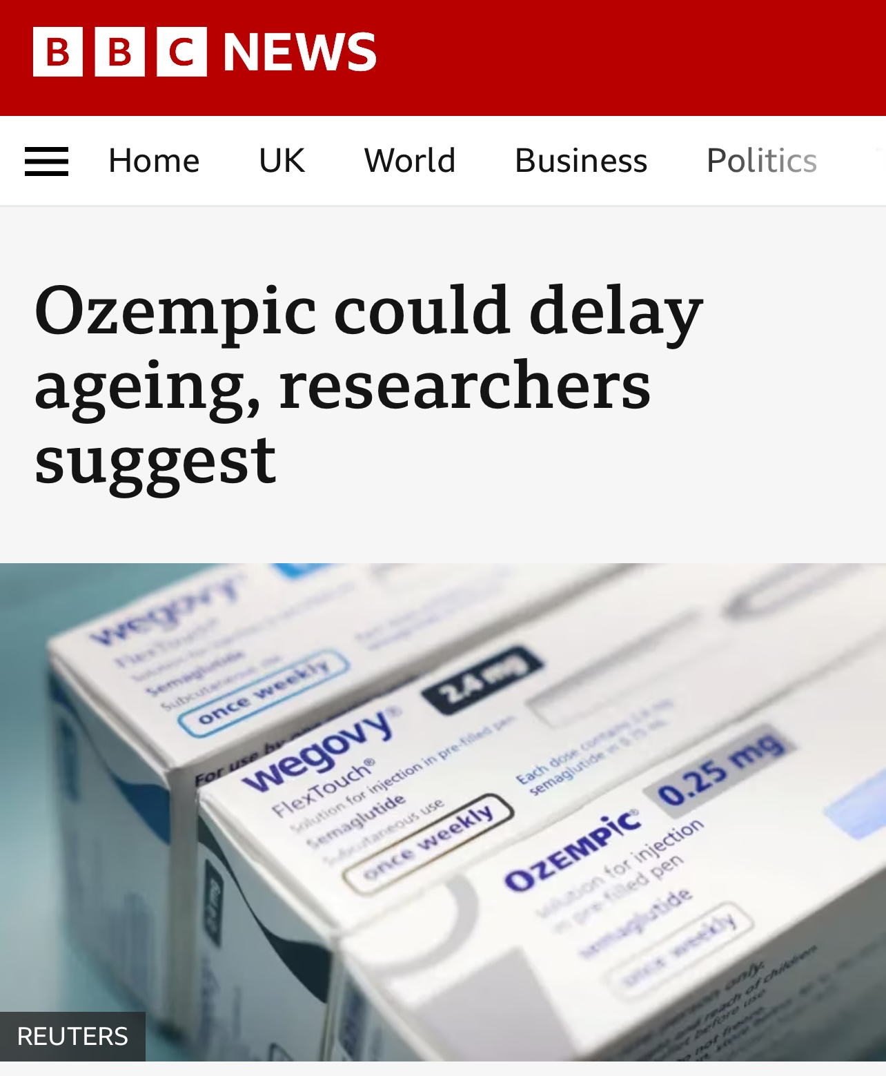


The Ozempic Shortage: A Growing Healthcare Challenge"

Slide 6
—Anonymous
“Yes, obesity is a disease just as worthy of treating as diabetes.”

Slide 7
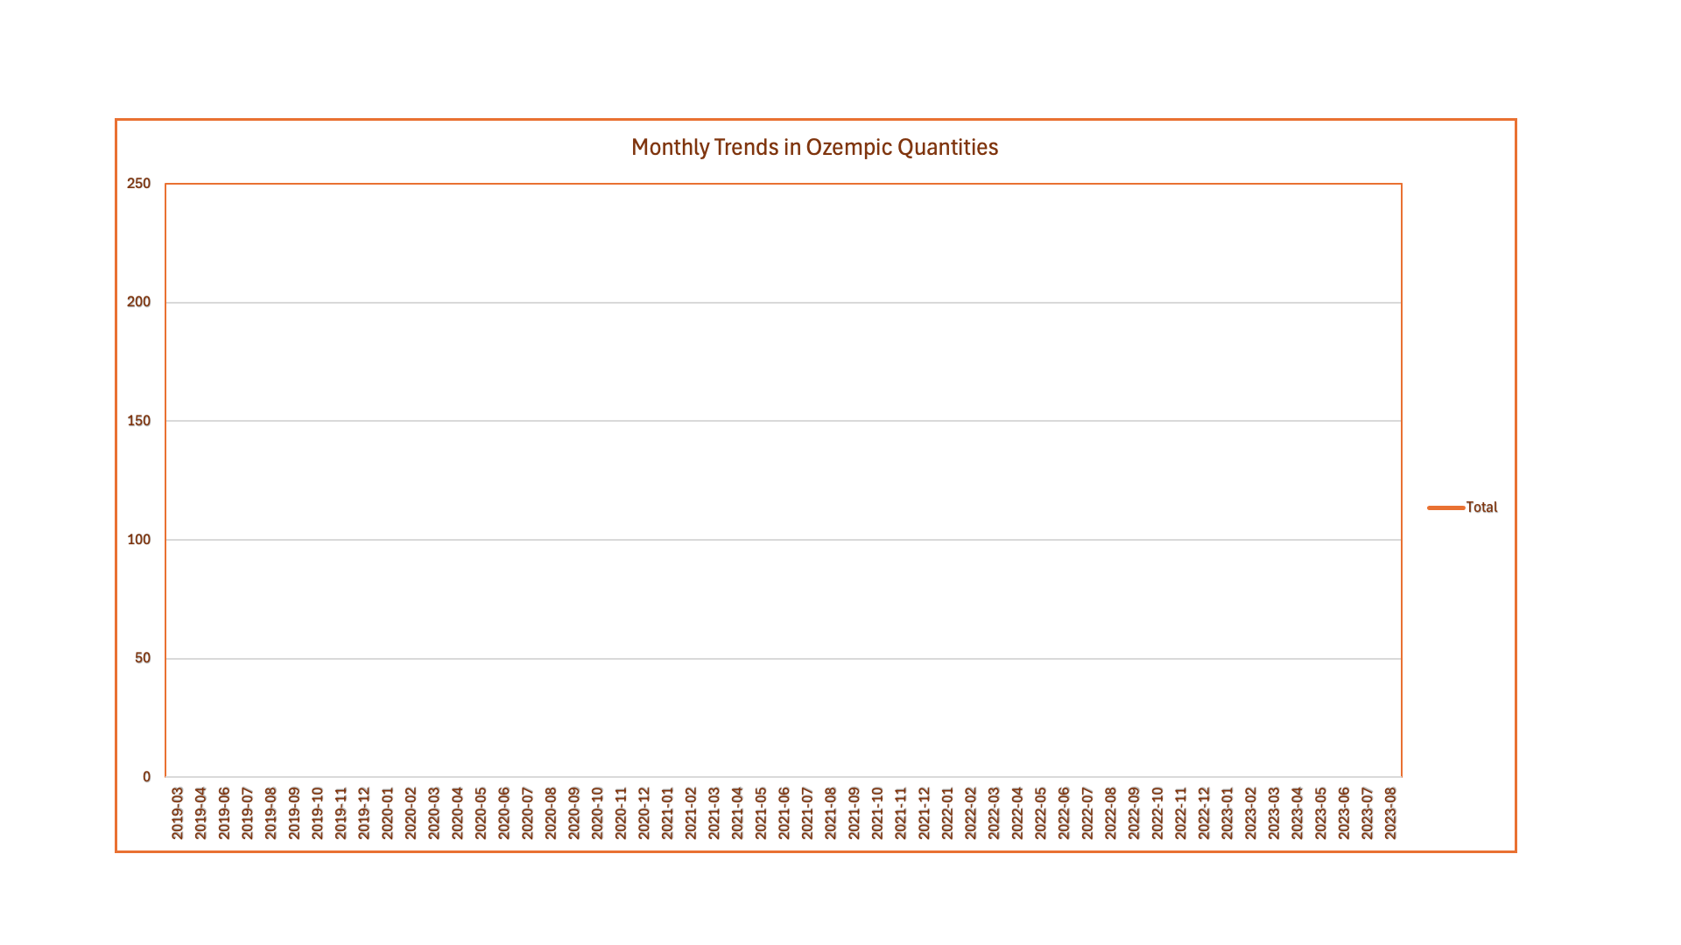
The Ozempic trend: 2019-2023

Slide 8

The organization
Novo Nordisk is a global healthcare company located in Denmark. It specialized in healthcare related to treating diabetes, obesity, growth hormone disorders and other chronic conditions. The company was founded in 1923 and is well known for being a leader in the management of diabetes. It has managed to develop several products that address the health needs of patients with diabetes, With operations in more than 80 countries, Novo Nordisk prioritizes innovation and sustainable methods in tackling global health issues (Novo Nordisk, 2023)

Slide 9
02
Objectives
General & Specific

Slide 10
Conduct sentiment analysis to gain insights into attitudes and opinions for informed decision-making.
Build a predictive model that would help healthcare providers by predicting the shortages that would occur and minimizing their impact.
Compare shortage impact ratings for diabetic medications.
Visualize trends in datasets to uncover meaningful patterns.

Slide 11
03
Framework
Conceptual

Slide 12
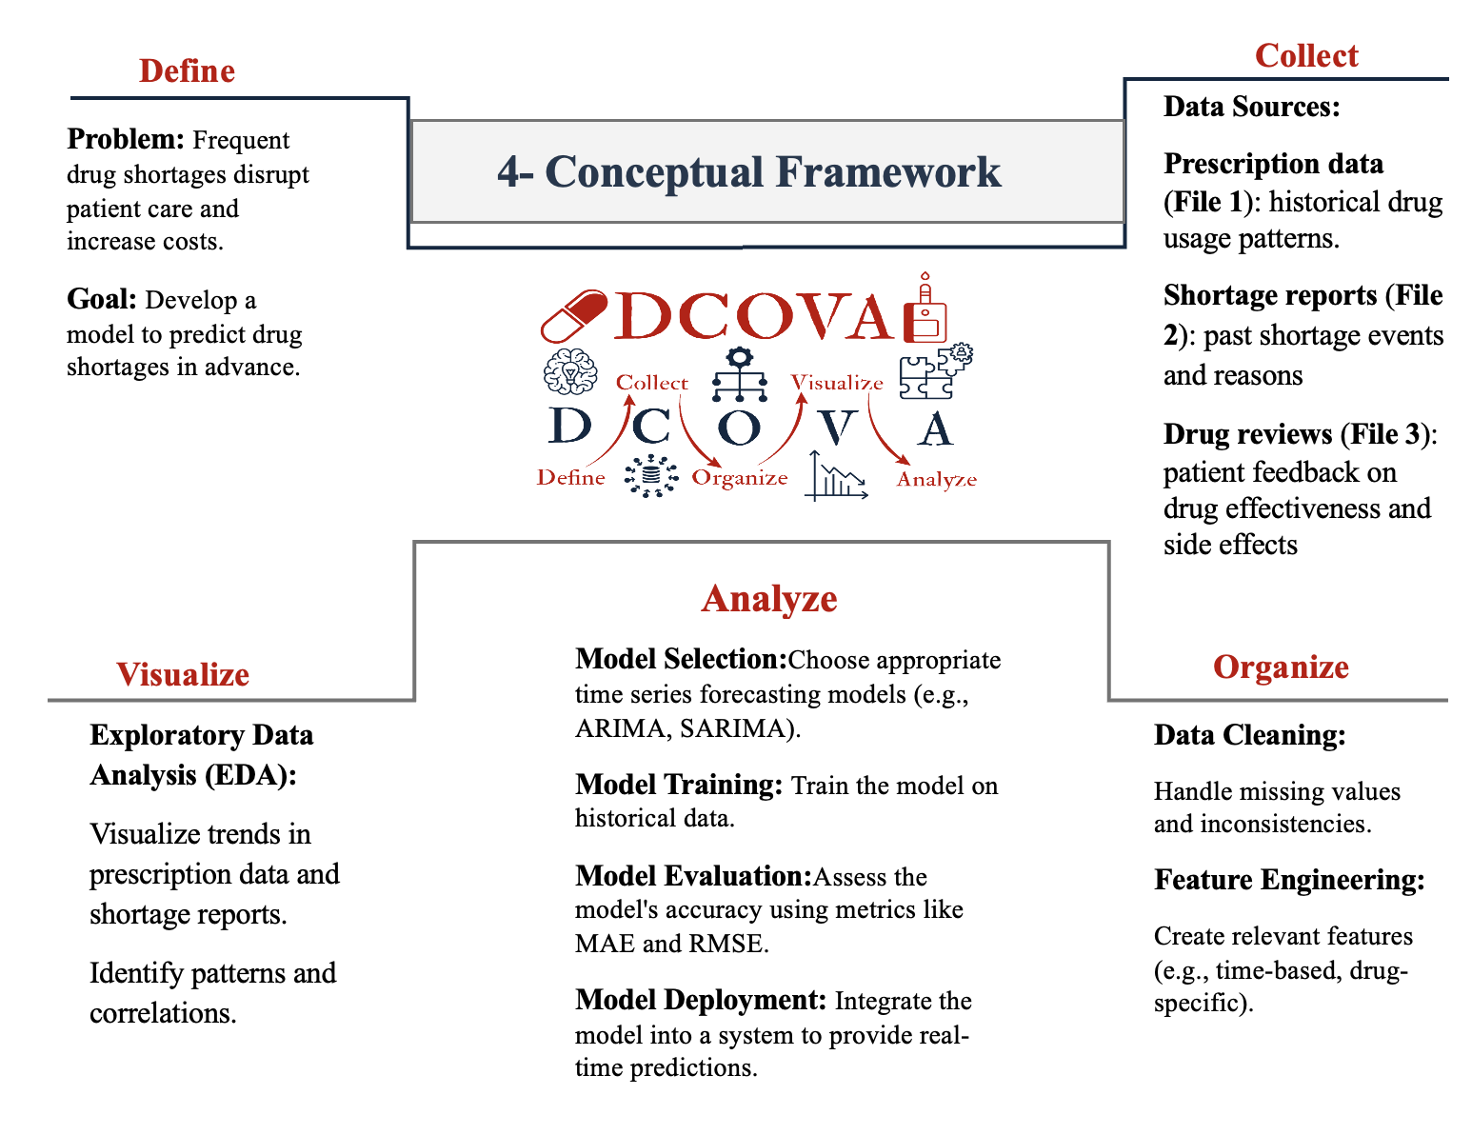

Slide 13
04
Data Description
Dataset & Overall Analysis

Slide 14
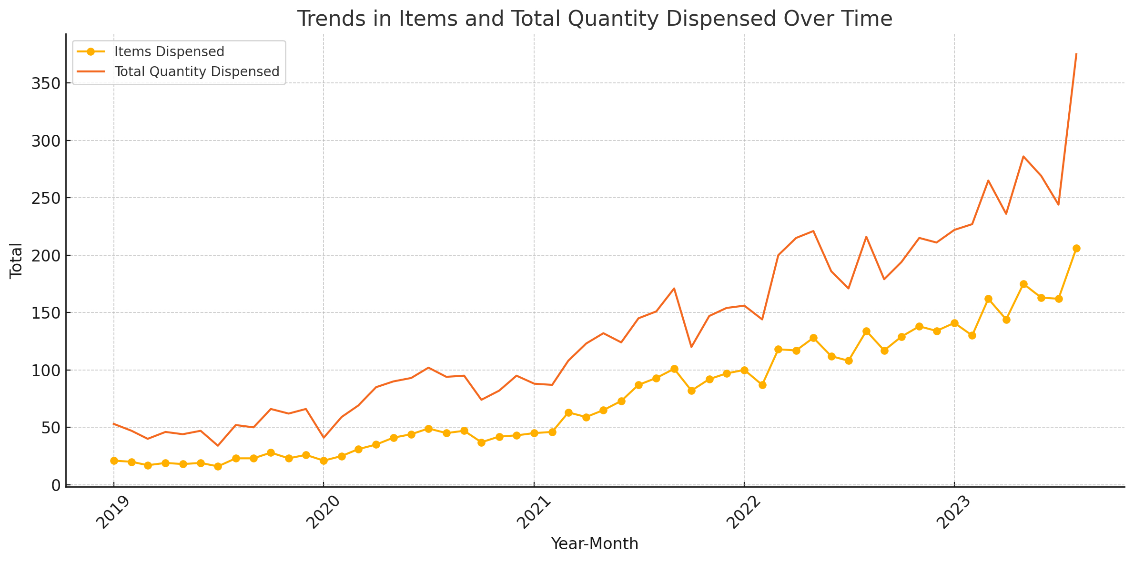
File 1: Prescription and Dispending of Medications
NHS- the national health service website for England.
• Items Dispensed:
Number of prescriptions fulfilled monthly.
• Total Quantity Dispensed:
Total amount of medication distributed monthly

Slide 15
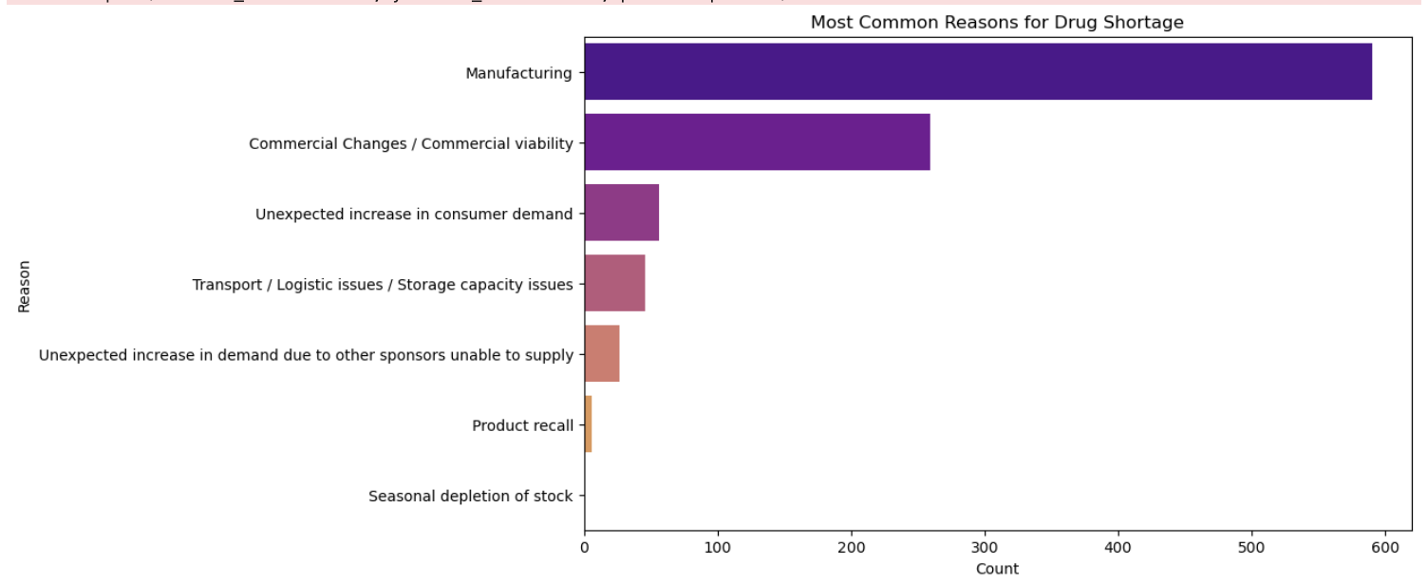
File 2 : Shortage Medications
Key Variables
DHAC- Australian Government Department of Health and aged care

Slide 16
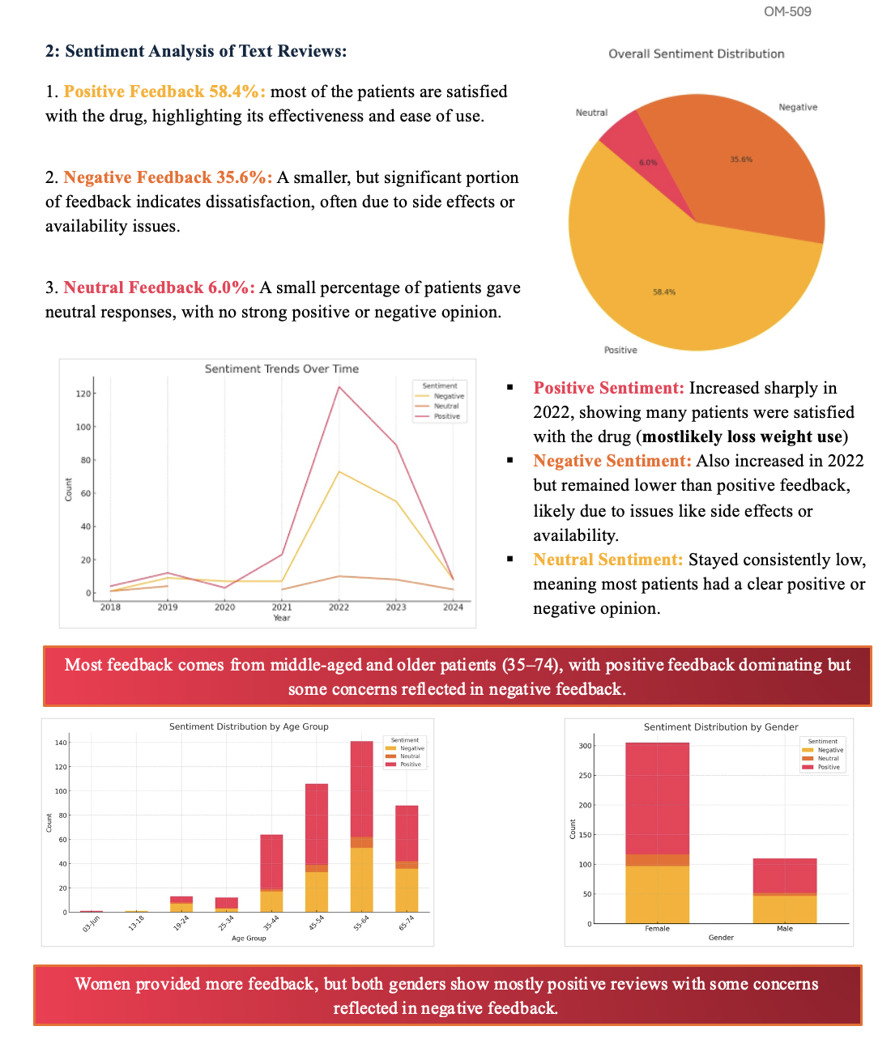

File 3: Reviews Dataset
?
Use qualitative data to apply opinion mining

Slide 17
05
Project Activity
Gantt Chart

Slide 18
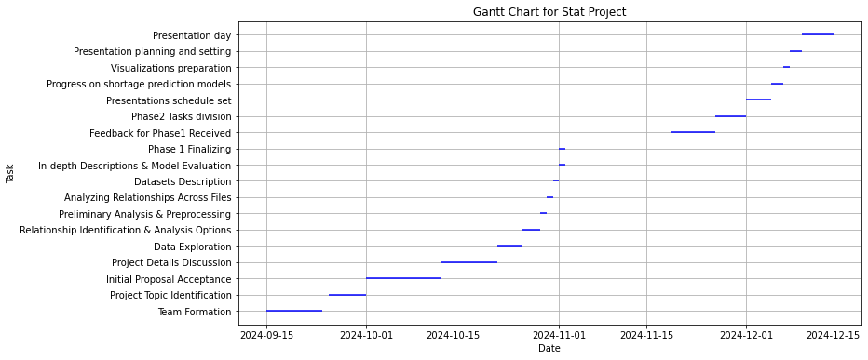

Slide 19
06
Model
Results & Interpretation

Slide 20
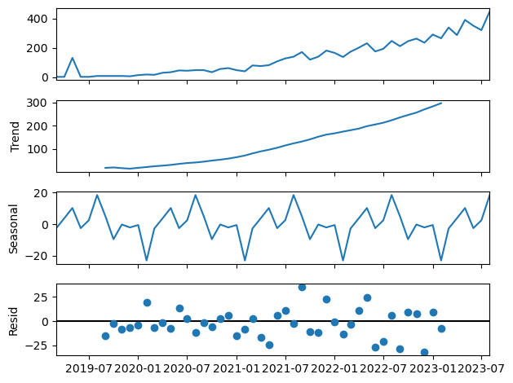
Seasonal Decomposition

Slide 21
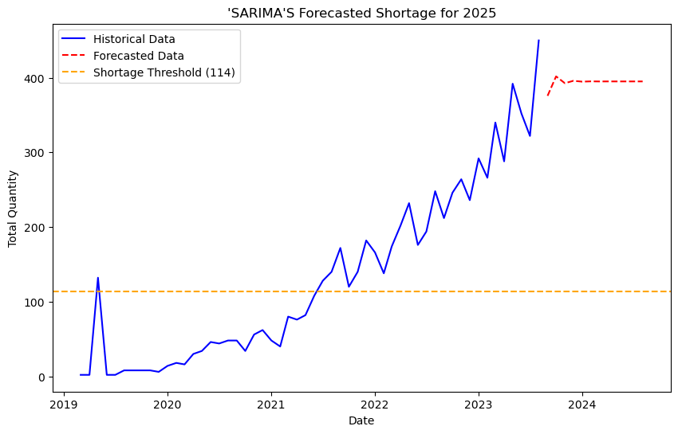

Slide 22
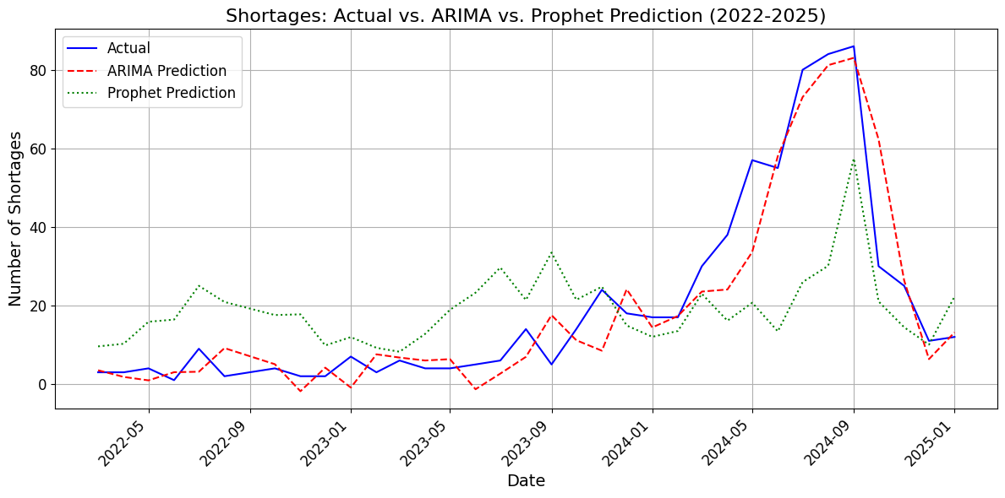

Slide 23
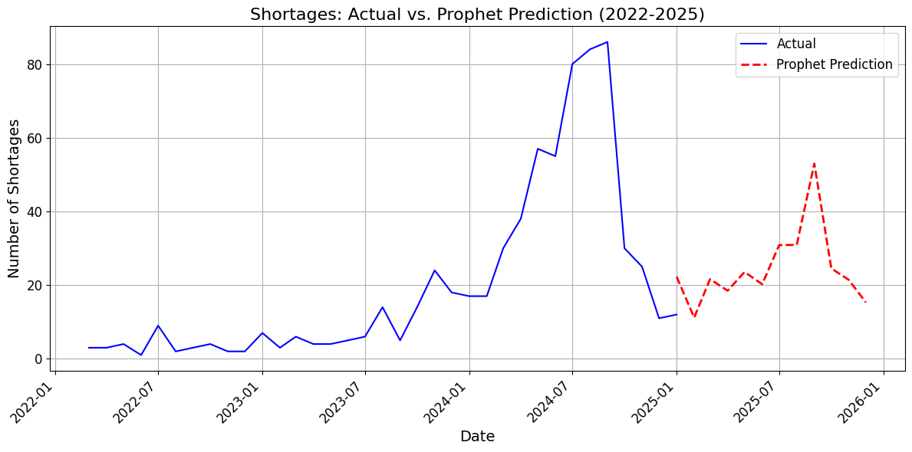

Slide 24
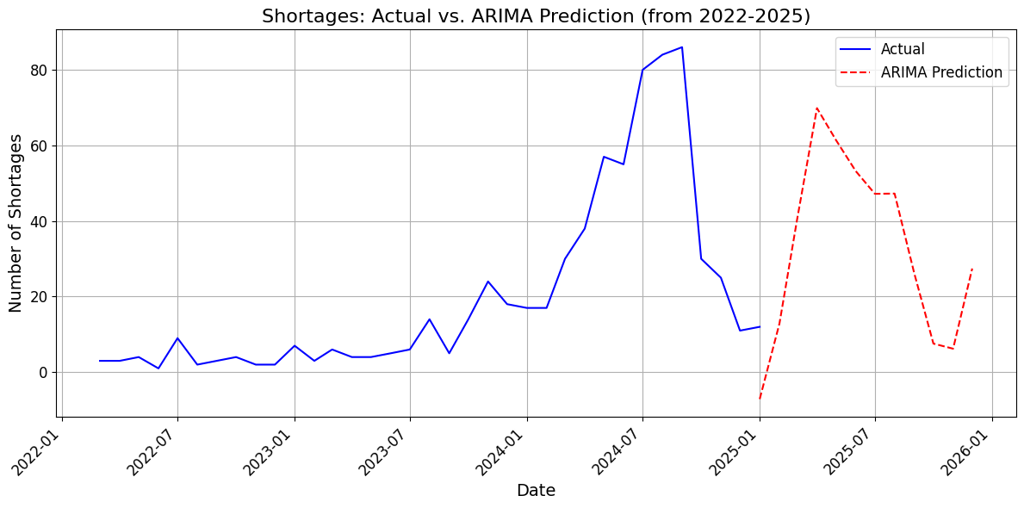

Slide 25
Evaluation Metrics
SARIMA:
RMSE: 36.99 MAE: 25.59
Prophet:
RMSE: 20.5 MAE: 15.3
ARIMA:
RMSE: 8.8 MAE: 5.8

Slide 26
07
Recommendations
Lessons Learned and Future Work

Slide 27





Recommendations
Prepare for
Fluctuations
Resource
Planning
Acknowledge
Limitations
Contingency
Plans
Risk
Management

Slide 28
Future work
1
Feature engineering
for more detailed analysis like the number of fluctuations in the trends, length of shortage periods, etc...
techniques such as Exponential Smoothing, Moving Average, Naive Bayes
2
Alternatives
3
Quantifying
Take a new approach to quantifying the number of units in shortage periods.
4
Analyze
Analyze text data for keyword analysis & theme detection.
5
Supply vs Demand
for sophisticated inventory buffering recommendations.

Slide 29
Lessons learned
Gained extensive experience in using Python for data analysis in both Jupyter & Google Collab.
Developed a skill of utilizing Generative AI assistance in applying Data Analysis.
Applied Data Analysis steps (i.e. Collecting, Analyzing, Cleaning/ Preprocessing, Visualizing, etc...)
Time Series Analysis & Prediction through ARIMA, SARIMA, and Prophet techniques.- Sentiment Analysis to analyze emotional tone from qualitative data.
Utilization of multiple datasets in one project to connect the dots.

Slide 30


Thanks!
Do you have any questions?

